Slide 1

Gold Price Prediction Using Unsupervised Learning Techniques
Presented By
B Sai Bhargav
A Akhila
M Likitha

Slide 2
ABSTRACT
The most valuable metal in the world is gold. It is the most sought-after commodity available. The study and forecasting of the daily gold price rate and the future gold price rate using machine learning algorithms and methodologies. Due to the multifactorial and nonlinear structure of the gold market, it is impossible to anticipate the gold price, which is influenced by a variety of external variables like marketing conditions, economic crises, oil price rate hikes, tax benefits, and interest rates.This project focuses on the study and forecasting of daily and future gold prices using machine learning algorithms. By applying ensemble-based techniques, particularly the ARIMA model, this research aims to enhance predictive performance. The model is trained on a gold price dataset from 2014 to 2022, with accuracy measured using performance metric like Root Mean Square Error (RMSE). This study demonstrates the potential of machine learning in financial forecasting, specifically for commodity markets.
Keywords:Gold, price prediction, machine learning, ARIMA model, financial forecasting, commodity markets, RMSE.

Slide 3
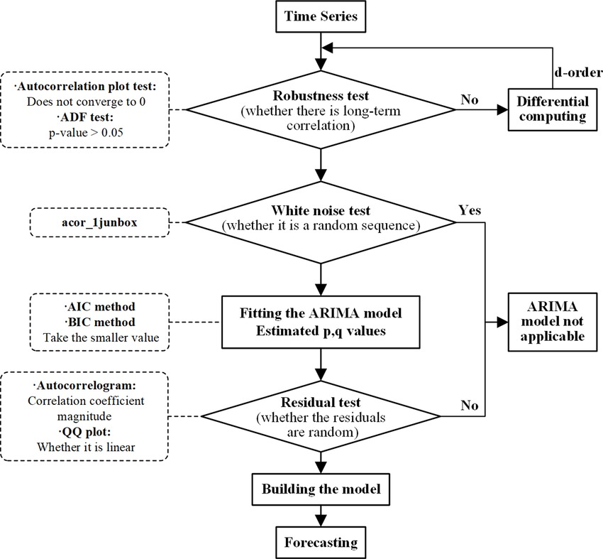
INTRODUCTION
A time series represents data points collected or recorded at consistent intervals over time, capturing temporal dependencies and patterns such as trends, seasonality, and noise. Time series forecasting aims to predict future data points by leveraging these temporal patterns.
The ARIMA model is used when the time series data is non-seasonal and stationary, meaning it shows no consistent repeating patterns over time. After the first differencing of the data to remove trends and achieve stationarity, ARIMA can be applied to model the relationship between observations and residuals. On the other hand, the SARIMA model is used when the time series data exhibits a seasonal pattern, such as monthly or quarterly fluctuations. After the second differencing, which addresses both trend and seasonality, SARIMA is applied to capture these repeating cycles and seasonal effects. SARIMA is ideal when both trend and seasonality are present in the data.

Slide 4

Investments in gold prices are driven by prediction methods classified into two groups: technical analysis and fundamental analysis. Fundamental analysis focuses on an organization’s financial health, including balance sheets, revenue, and economic conditions, while technical analysis, or charting, predicts future trends based on past data patterns. Financial forecasting is vital for economic growth, as it helps inform critical investment decisions. In today’s data-driven world, processing and analyzing financial data has become more complex, with numerous factors influencing commodity prices like gold.
Using unsupervised time series analysis, we apply the ARIMA model to forecast gold prices for the next two years. This is based on historical data patterns from previous years, aiming to capture trends and fluctuations. The ARIMA model helps predict future price movements, making it an essential tool for informed investment strategies and financial planning in the gold market.

Slide 5
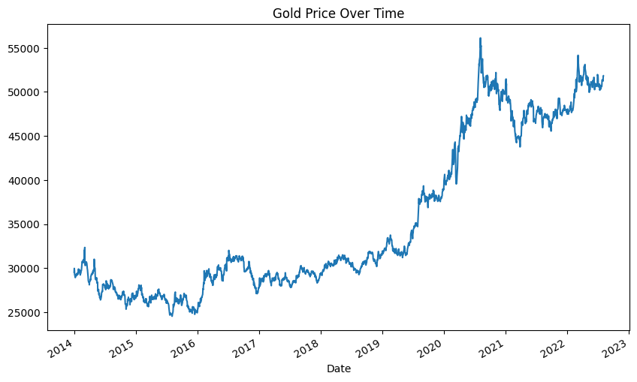
EXPLORATORY DATA ANALYSIS
1. Describing the Data:
- Analyzed the statistical summary of the dataset to understand the basic distribution of values.
2. Checking for Null Values:
- Verified that there are no missing values in the dataset.
3. Converting Date Column to Datetime:
- Converted the Date column to a datetime data type for proper time series analysis.
4. Setting 'Date' as Index:
- Set the 'Date' column as the index to facilitate time series operations and visualizations.

Slide 6
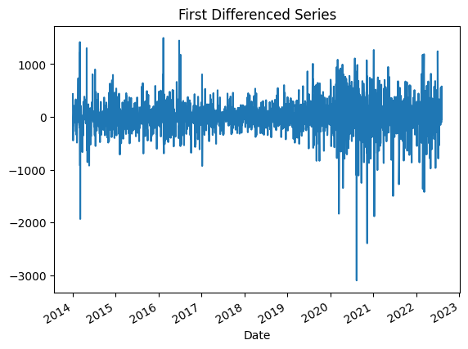
EDA
Continution
5. Visualizing Gold Price Over Time:
- Plotted the gold price trend over time.
- Observed that the gold price is following a trend with no seasonal cycles over the time period.
6. Testing for Stationarity:
- Conducted a stationarity test (e.g., Augmented Dickey- Fuller test) on the original price data.
- The p-value was >0.05, indicating that the data is non- stationary.
7. Performing First Differencing:
- Differenced the time series data to remove the trend and stabilize the mean.
- After first differencing, the p-value became <0.05, confirming that the data is now stationary.
8. Preparing for Model Application:
- With the stationary data, the next step is to apply the forecasting model (such as ARIMA).

Slide 7
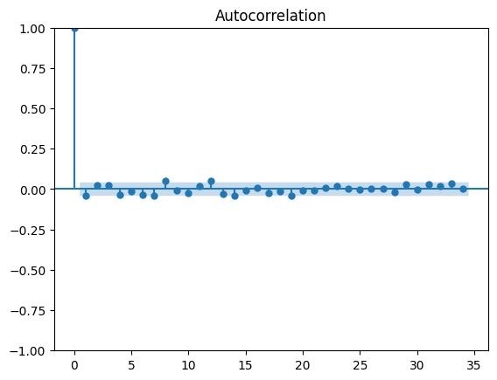
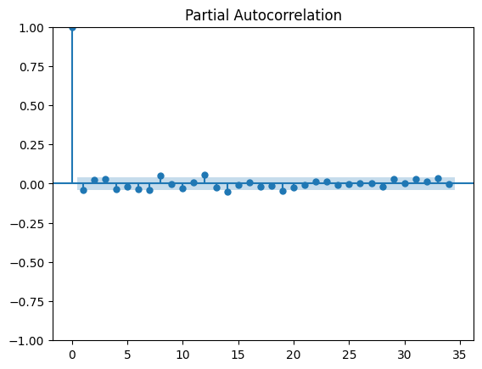
APPLIYING MODEL
1. Model Selection:
- Based on the analysis, ARIMA is chosen for gold price forecasting due to the trend characteristics and stationarity of the data.
2. Plotting Autocorrelation and Partial Autocorrelation:
- Draw ACF (Autocorrelation Function) and PACF (Partial Autocorrelation Function) plots to determine the appropriate parameters (p, d, q) for the ARIMA model.

Slide 8
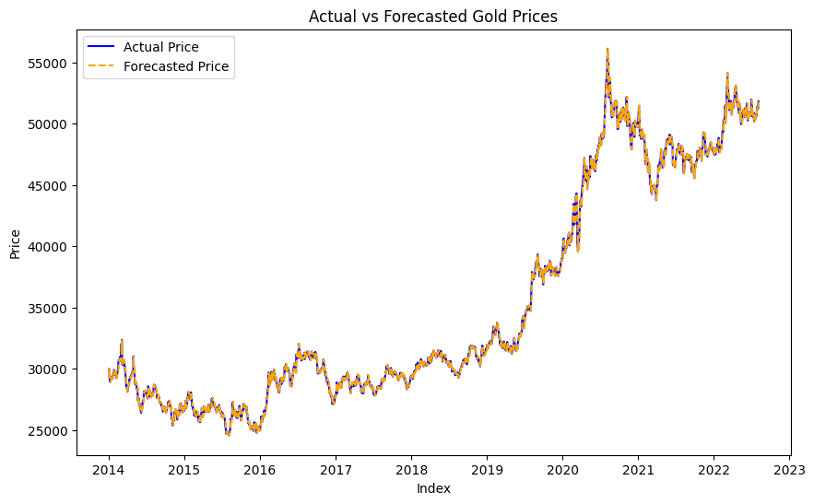
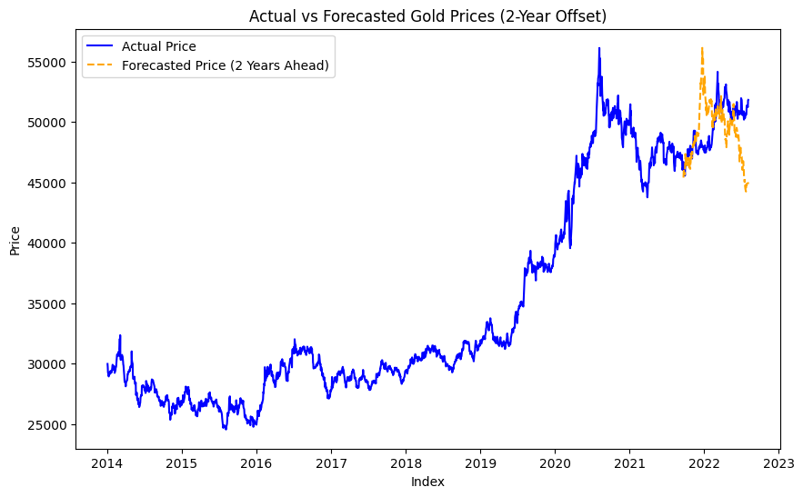
3.Training and Fitting the ARIMA Model:
- Fit the ARIMA model to the training data based on the identified parameters from the ACF and PACF plots.
4. Model Evaluation:
- Evaluate the model's performance by calculating the Root Mean Square Error (RMSE) to assess the accuracy of the predictions.
5. Forecasting Future Prices:
- Use the fitted ARIMA model to forecast gold prices for the next two years, providing insights for potential future trends in gold pricing.

Slide 9
APPLICATION
Use the application to make data-driven investment decisions in gold.
Assist financial advisors in providing clients with insights about gold investments.
Enable traders to anticipate market trends and adjust their trading strategies.
Support mining companies in strategic planning and operational decision-making.
FUTURE SCOPE
Develop a real-time forecasting system based on live market data.
Include more external variables like geopolitical events and inflation rates.
Explore advanced machine learning techniques like deep learning.
Create a user-friendly application interface for non-technical users.
Integrate sentiment analysis from news articles and social media.
Collaborate with financial institutions for real-world trading applications.

Slide 10
CONCLUSION
1. Integrating sentiment analysis improves the prediction model by capturing market dynamics influenced by public opinion.
2. Using news articles and social media data enhances the model's accuracy, providing insights into the impact of sentiment on gold prices.
3. This approach supports more informed investment decisions and strengthens financial forecasting for commodities like gold.
REFERNCES
[1].Gold Price Prediction using ARIMA model ,D Nanthiya, SB Gopal, S Balakumar, M Harisankar, SP Midhun.
[2].Developing a time series model based on particle swarm optimization for gold price forecasting
E Hadavandi, A Ghanbari… - 2010
[3]. A novel hybrid model on the prediction of time series and its application for the gold price analysis and forecasting E Jianwei, J Ye, H Jin - Physica A: Statistical Mechanics and its …, 2019

Slide 11
THANK YOU

